Slide 1
BIODEGRADABLE AIR FILTER USING BANANA FIBER
GUIDED BY,
Mr. VENUGOPAL N
ASSISTANT PROFFESSOR
PRESENTED BY,
GROUP- 8
Mr. L K DEVAN
Mr. MUHAMMAD ASHFAQ N
Mr. SHINAS SHERIEF

Slide 2
INTRODUCTION
Air pollution is a big issue that the world is facing now.
In 2019, pollution was responsible for approximately 9 million premature deaths.
Assuring quality air even at home or work place is the basic need of human beings.
Ensuring pure air in the closed spaces like homes and offices and other spaces will reduces the impact of air pollution.
Well the usage of standard air filters will also lead to landfill every year, and those are not able to recycled in a proper way.
To address these issues, we are developing biodegradable air filters.

Slide 3
OBJECTIVES
Developing an air filter using banana fibers
Achieve sustainability and reduce the environmental impact
Banana fiber offers a cost-effective alternative to traditional air filter materials

Slide 4
LITERATURE REVIEW
SL No | AUTHORS | TITLE | YEAR | INFERENCE
1 | How efficiently can HEPA purifiers remove priority fine and ultrafine particles from indoor air? | How efficiently can HEPA purifiers remove priority fine and ultrafine particles from indoor air? | 2020 | Standard air filters in HVAC systems capture particles to enhance indoor air quality. They're rated by MERV; higher ratings capture smaller particles but may restrict airflow. Specialized air purifiers use HEPA, activated carbon, and UV-C light for comprehensive purification. However, their non-biodegradable nature poses environmental risks, urging responsible disposal and eco-friendly material advancements for reduced environmental impact
2 | Vinay Kumar a, Pritha Chakraborty b, Poonam Janghu c, Mridul Umesh d | Potential of banana based cellulose materials for advanced applications: A review on properties and technical challenges | 2023 | Banana-based biopolymers offer eco-friendly alternatives to synthetic materials, serving various industries from medical to environmental sectors, showcasing their potential for sustainable solutions and waste utilization

Slide 5
SL No | AUTHORS | TITLE | YEAR | INFRERENCE
3 | Jagriti Saini a, Maitreyee Dutta b, Gonçalo Marques | Smart indoor air quality monitoring for enhanced living environments and ambient assisted living | 2023 | The AQI serves as a tool for the public, environmental agencies, and policymakers to understand and communicate the air quality status. It helps individuals make informed decisions regarding outdoor activities, and it aids in implementing appropriate measures to improve air quality and protect public health.
4 | Ye Bian a, Chencheng Zhang a, Hui Wang b, Qi Cao | Degradable nanofiber for eco-friendly air filtration: Progress and perspectives | 2023 | Air pollution is a major global health threat, but traditional filters contribute to waste issues. Unlike non-degradable counterparts, these filters don't disrupt waste disposal systems. This review explores the latest in degradable nanofiber filters, detailing their composition, filtration performance, and various functionalities. The aim is to create sustainable air filters that meet future needs while being kind to the environment

Slide 6
WHY BANANA FIBER ?
High tensile strength
flexibility
Low weight
Biodegradability
Non toxic
Renewability

Slide 7
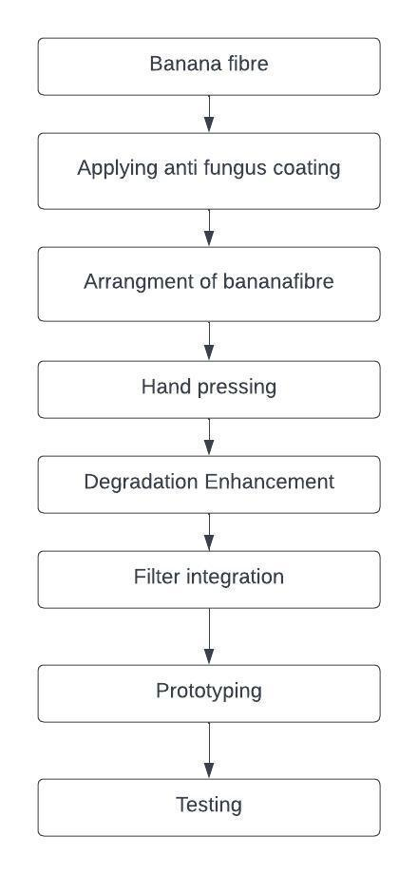
METHODOLOGY

Slide 8
CLEANING PROCESS OF BANANA FIBRE
Choose the cleaning agent
Scouring
Bleaching process(try to avoid the fungal attack)
Rinsing
Drying

Slide 9
REQUIRED MATERIALS AND COST
Materials | Required Amount | Cost (Rs)
Rubber pad | 3 | 2400
Silicon paste | 3 | 600
Blower | 1 | 1250
Cable tie | 6 | 60
Banana fiber | 1500 gram | 1500
Epoxy | 3 | 750

Slide 10
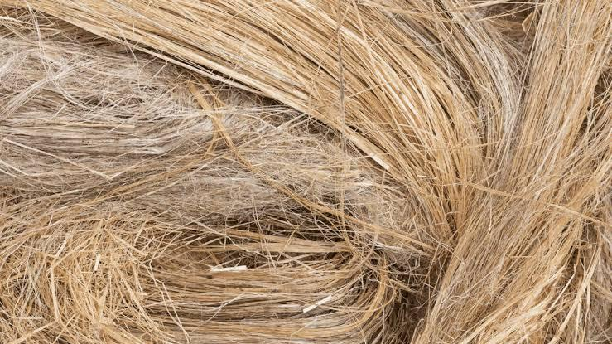
MATERIALS PURCHASED
1. Banana fibre

Slide 11
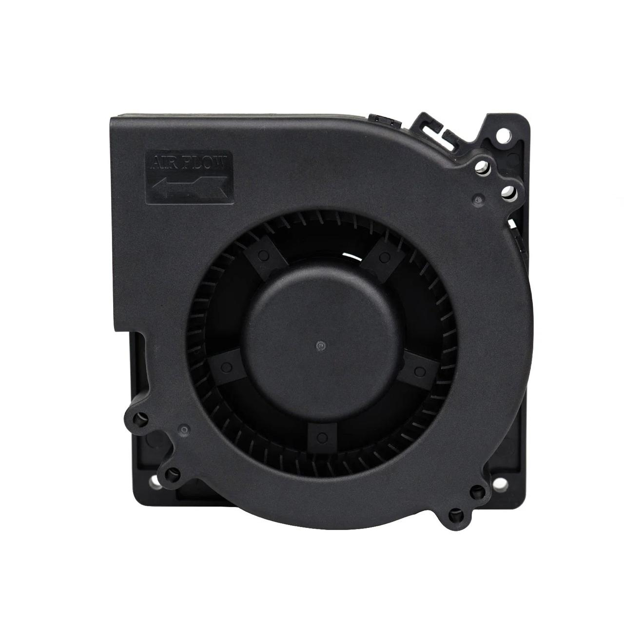
2. BLOWER

Slide 12
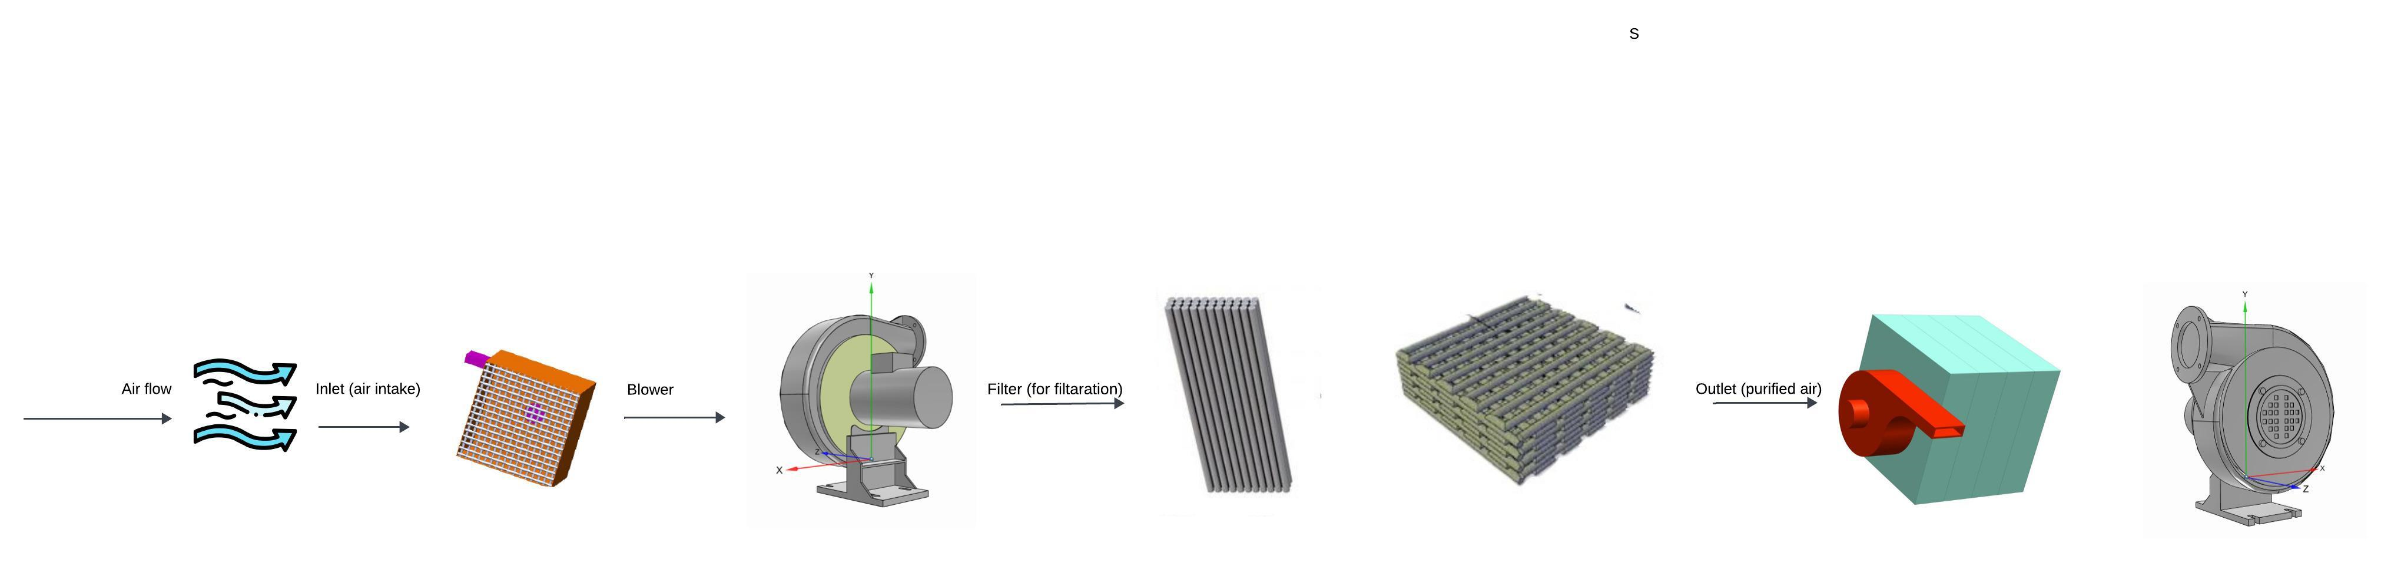
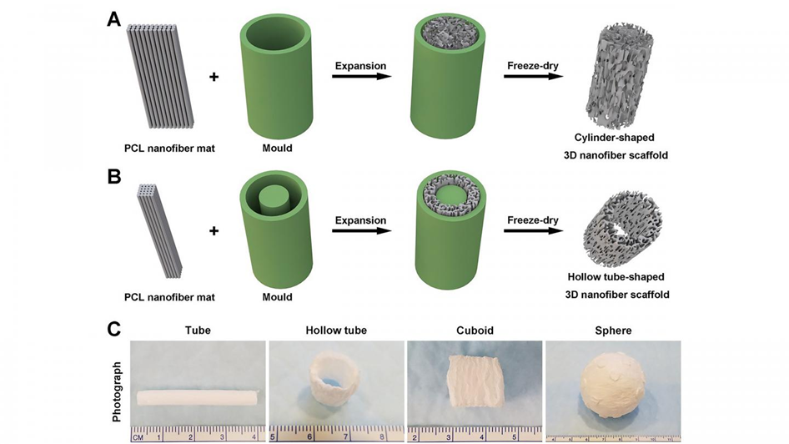
Flow diagram

Slide 13
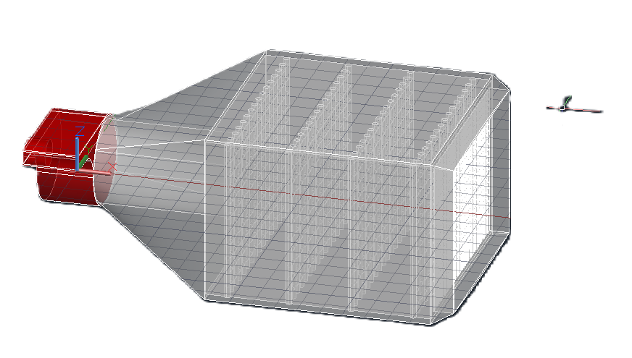
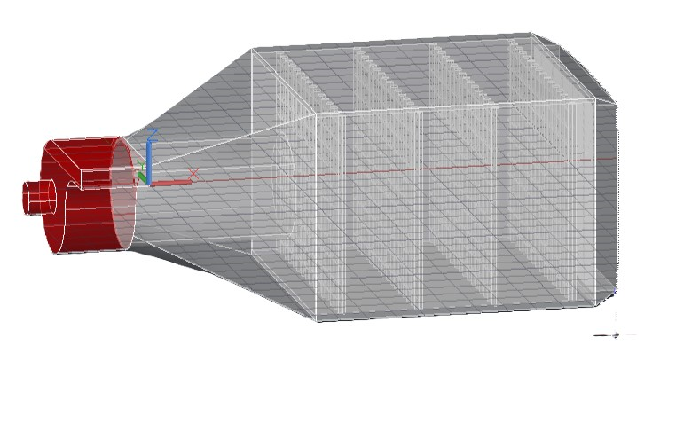
CAD MODEL

Slide 14
TESTING
Particle Filtration Efficiency Testing

Slide 15
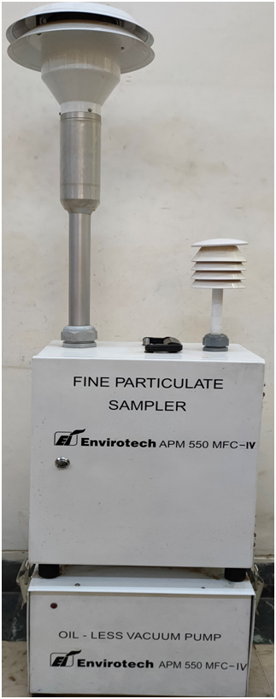
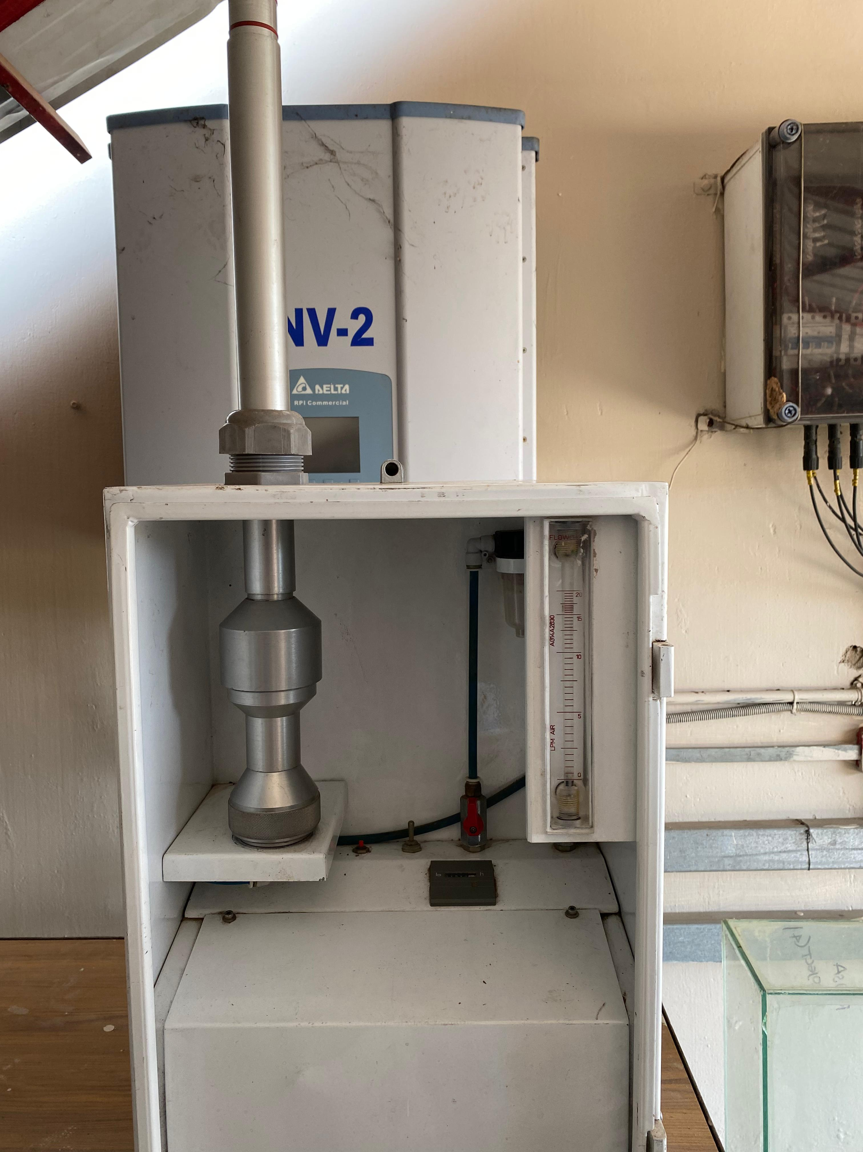
TESTING EQUIPMENT
APM-550-MINI

Slide 16
This device is a portable sampler used to monitor the ambient air quality
It is used to measure fine particles including PM and PM2.5

Slide 17
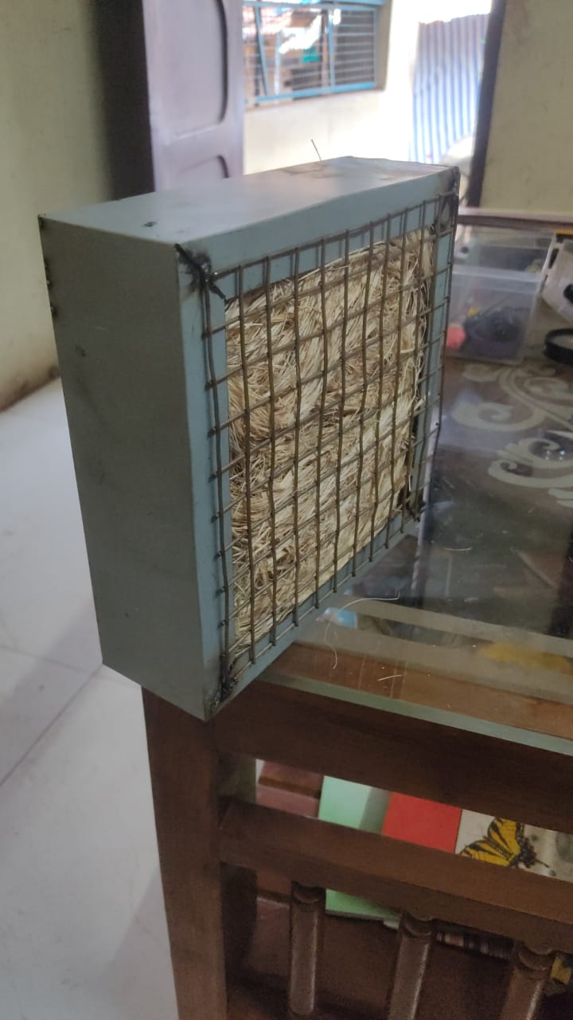
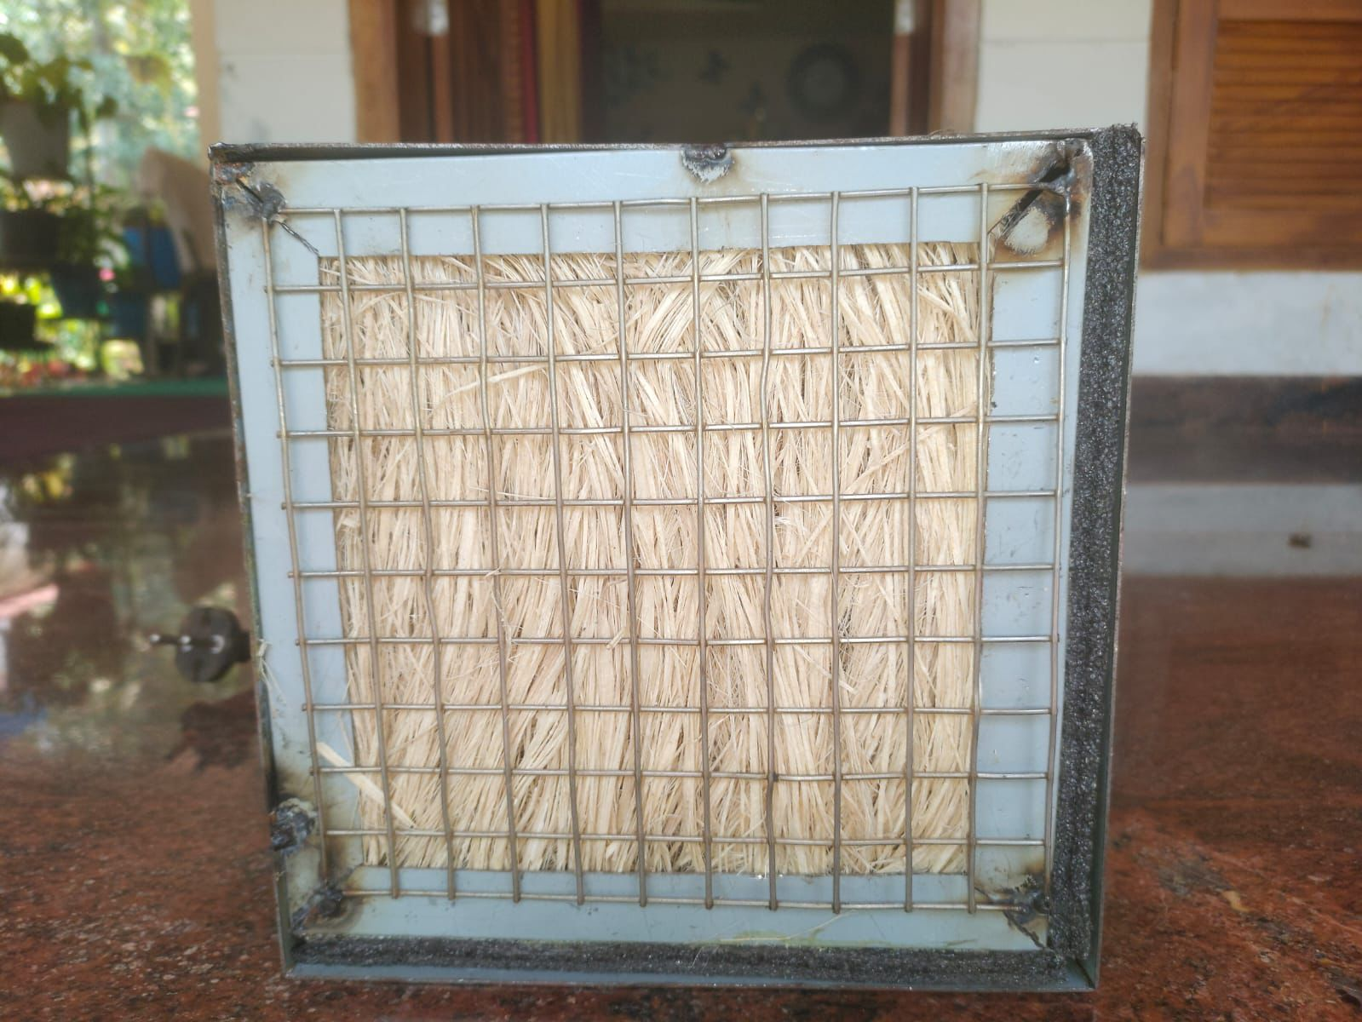
FILTER ARRANGEMENT

Slide 18
Here we are doing hand pressing in order to arrange the fiber in the respective cases
Since the size of the fiber is very less, stacking fiber one by one is not practically possible
That is why we choose hand pressing.

Slide 19
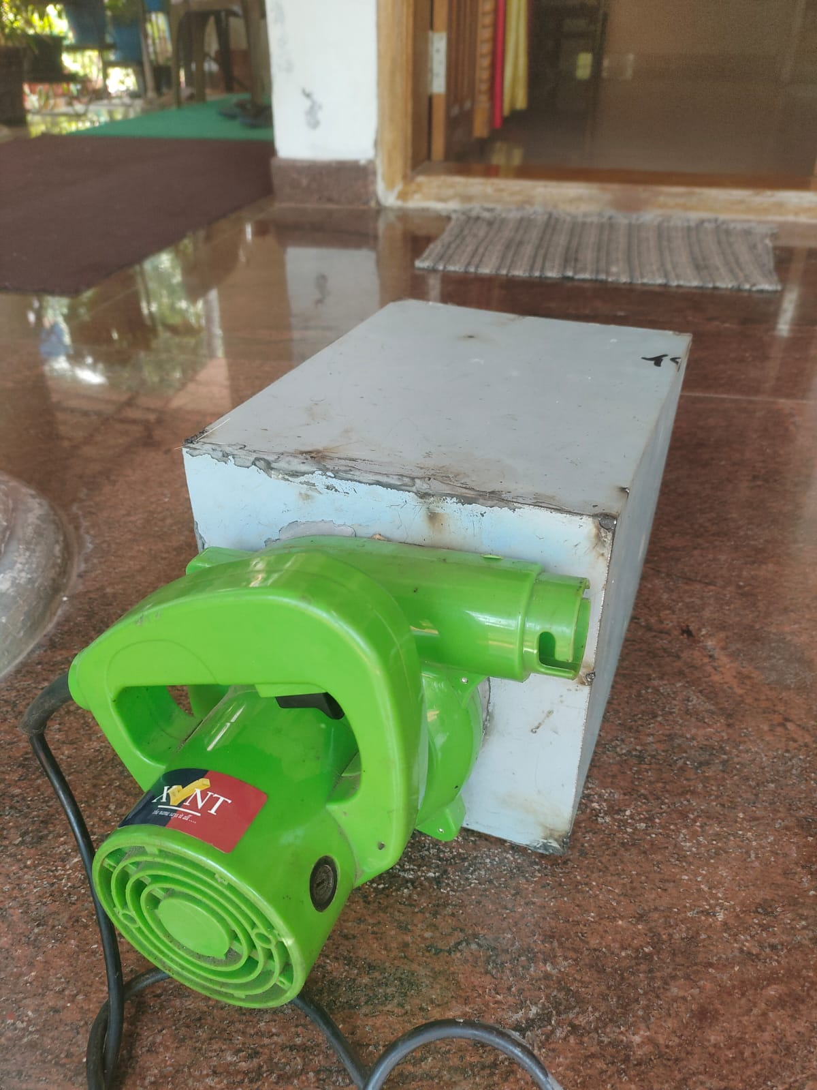
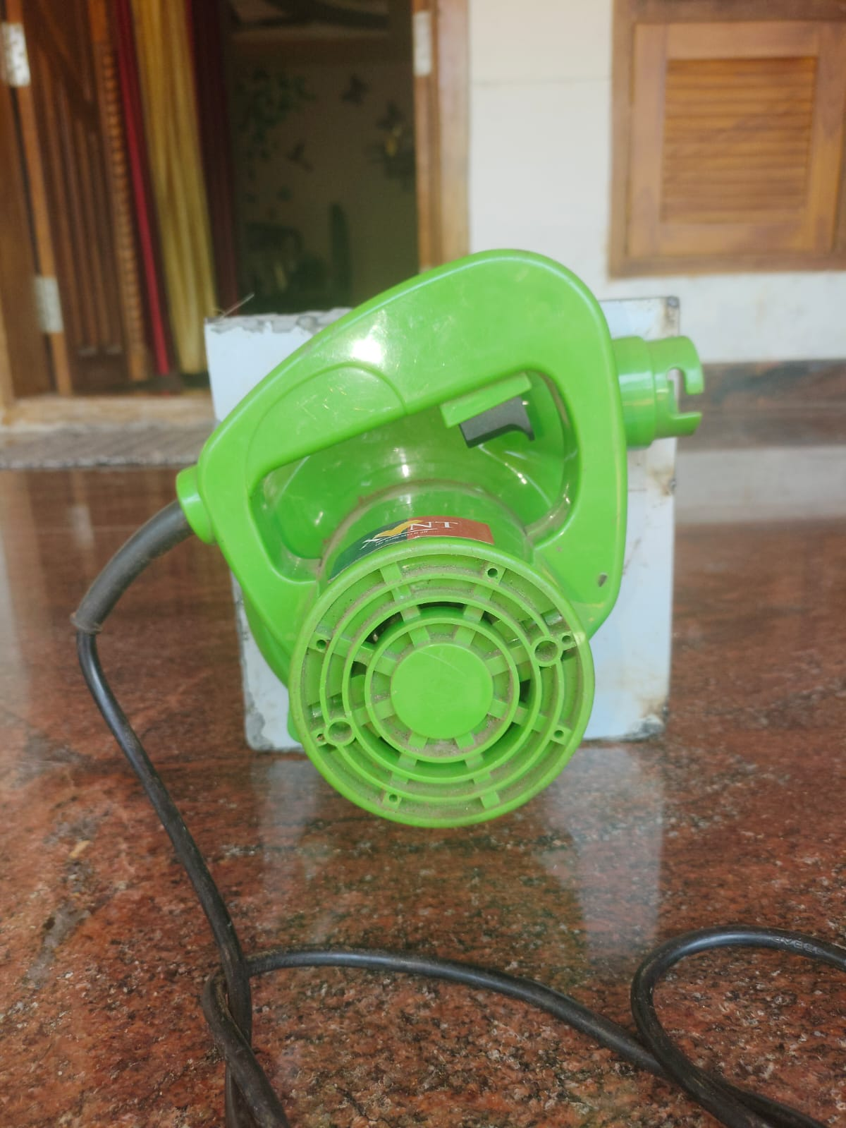
FINAL PRODUCT

Slide 20
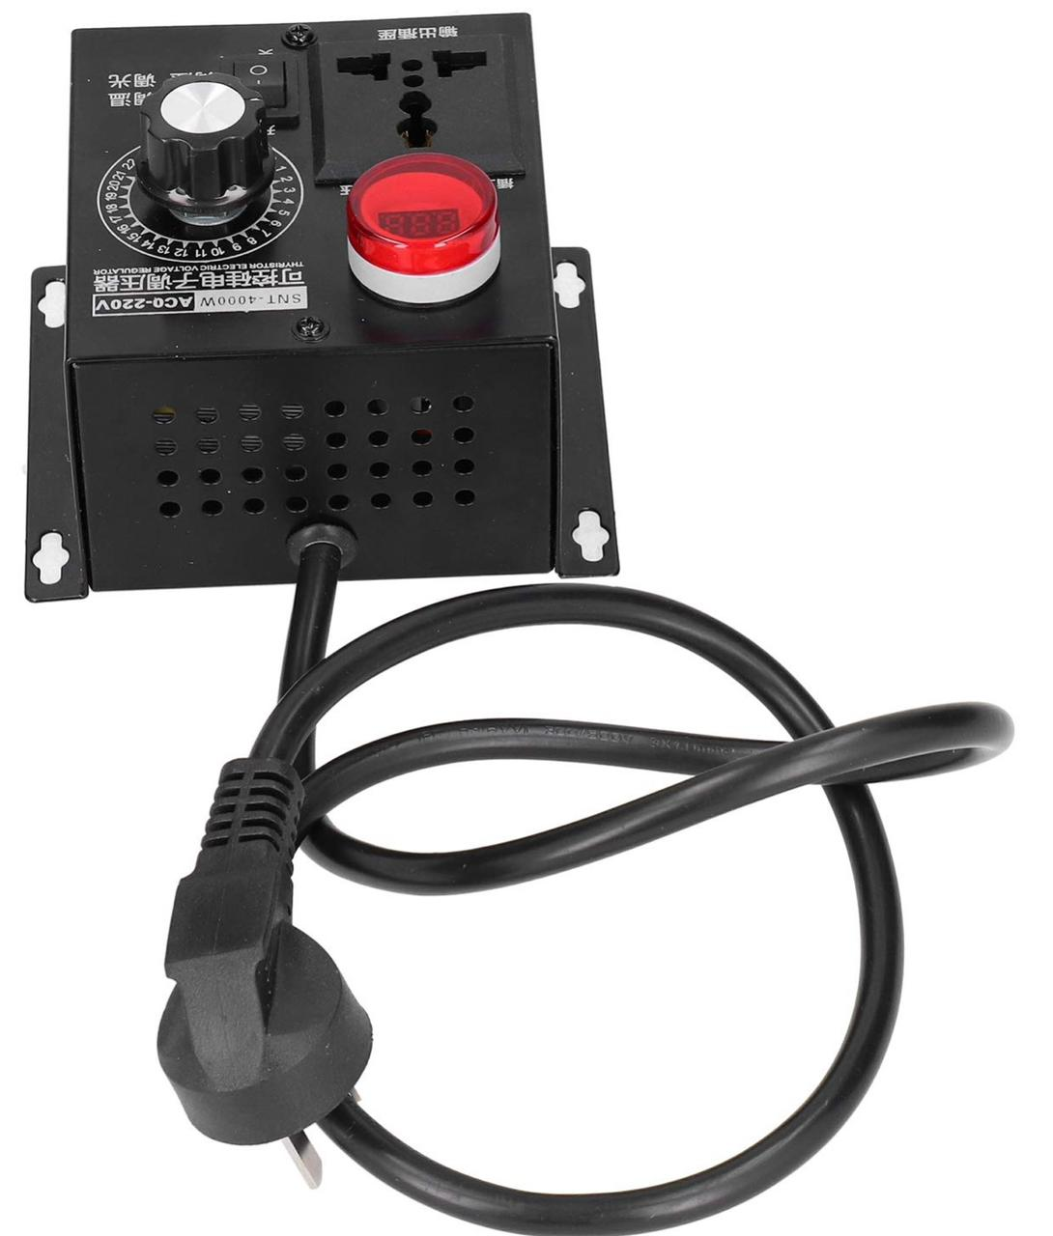
WHY THYRISTOR IS USED ?
It is used to control the flow of the blower
Thereby meeting the need to test our product

Slide 21
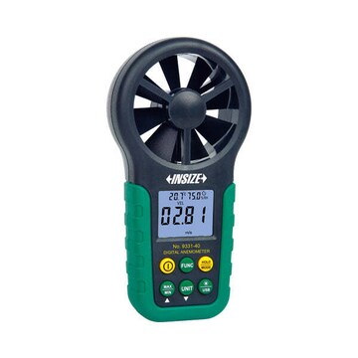
WHY ANEMOMETER IS USED ?
It is used to measure the air flow which is coming out through the blower
Thereby we can adjust the flow of the blower to our requirement with the help of thyristor

Slide 22
References
[1] Ye Bian, Chencheng Zhang, Hui Wang, Qi Cao; Degradable nanofiber for eco-friendly air filtration: Progress and perspectives, 2023.
[2] Jagriti Saini, Maitreyee Dutta, Gonçalo Marques; Smart indoor air quality monitoring for enhanced living environments and ambient assisted living, 2023.
[3] Daniela S. de Almeida a, Leila D. Martins b, Monica L. Aguiar; Air pollution control for indoor environments using nanofiber filters: A brief review and post-pandemic perspectives, 2022.

Slide 23
THANK YOU

